Slide 1
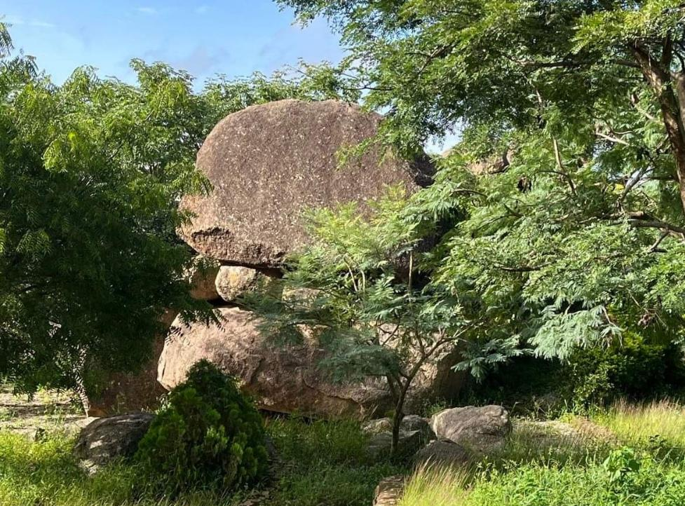
Chuck and Marci Cordon
Post Mission Campaign Report
Nigeria/Uganda
Aug 24 – Dec 1 2022
Link to Savannah Church of Christ Mission Page
Link to Concord Church of Christ
Notes:
Walking through the presentation with amplifying notes will give a good idea of our latest campaign period.
The Savannah Church of Christ, Savannah TN oversee our work and work fund: Savannah Church of Christ Missions page
https://1drv.ms/b/s!AnLLCb3KRCI_gc9TCLNac5-rBhQnIw?e=x8mDwE
Since Nov 2021 we have been serving in Concord NH as mission (interim preaching team): Concord Church of Christ
https://1concordchurchofch.wixsite.com/churchofchrist
Please use the links provided to access additional information. We are happy to provide any further information you might be interested in. Please share as desired.
Chuck Cordon (crcordon@msn.com)
(757) 639- 0277
141 Fisherville Rd.
Concord NH 03303
In all things, may the Lord be glorified in the partnership of this work. We are beyond words thankful for you in having a part in this.
Hey, please do us a favor...there are imbedded hyperlinks to photos and files in this presentation. I still working out how, what format to use in trying to get out these reports. If you cannot access the links, or something does not work...please let me know...cuz that ain't right and I must fix that.

Slide 2
Summary
Visiting Lecturer, School of Biblical Studies, Jos Nigeria
1st Year: Acts 3rd Year: Romans & Galatians
Preaching at local Jos Congregations
Project Work:
Water Boreholes
Distributing WVBS Evangelism Kits
Updates:
Student Food fund
Library Roof
Evangelist Support:
Uganda
Sierra Leone
Notes:
This slide provides an overview of the presentation areas
This was our third time out;
First (July – Dec 2019) Second (Jan – May 2021)
While continuing with our core work with the School of Biblical Studies, Jos Nigeria, we expanded our work this time around in evangelism and support for key evangelist teams.

Slide 3
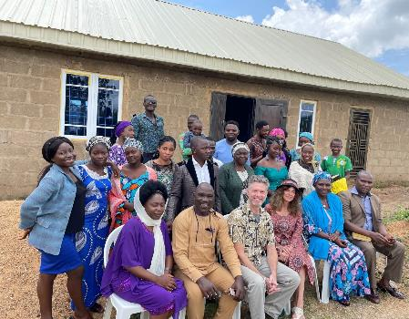
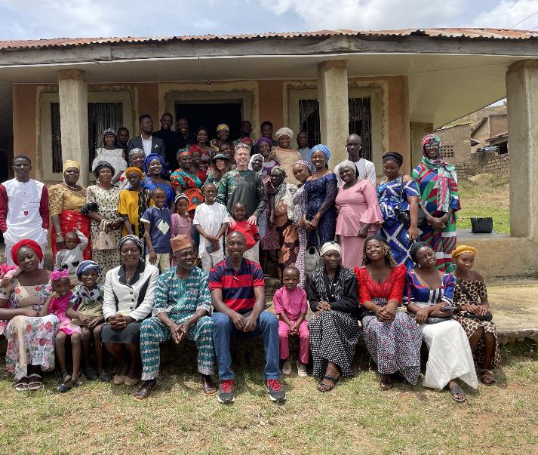
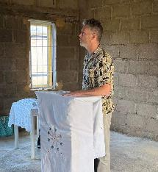
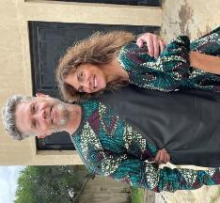
Vom
Anglo Jos
Notes:
The next set of slides provide a quick canvas of our regular mission work with local congregations around Jos.
There are many congregations seeded over the years, many an outgrowth from the presence of SBS Jos faculty and students.
We wish we could visit them all, but even within the local Jos area this is not possible. We get many more invitations than we can field.
The brethren are always so welcoming. Usually, we will work with a translator, but in some English is well understood
The brethren at the Concord church of Christ funded the roof, windows, and doors for the Vom church building

Slide 4
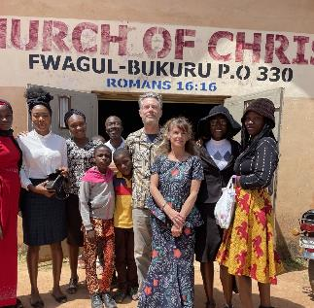
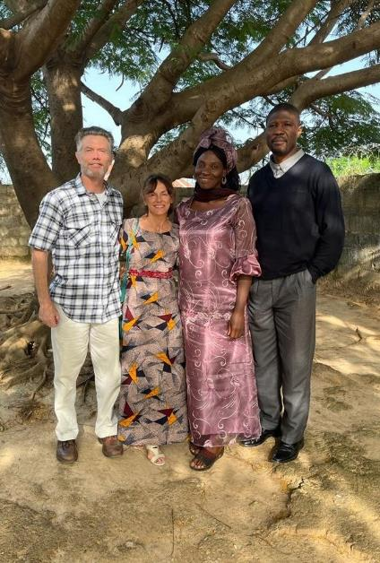
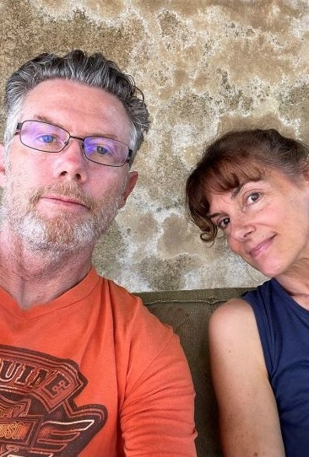
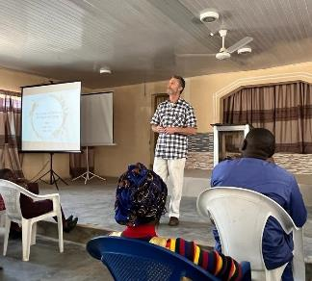
Timeout!
With Isaac & Chica (Alheri)
Bukuru
Notes:
Isaac is an elder at the Alheri church and his wife, Chica is a teacher at the SBS school (English)
Relaxing at the swing on the front porch of the house we live at on campus.
A faculty member at Jos is the preacher, and an elder at the Bukuru church of Christ

Slide 5
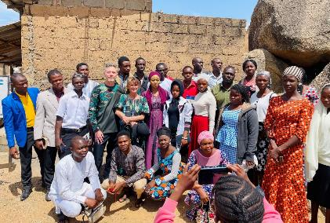
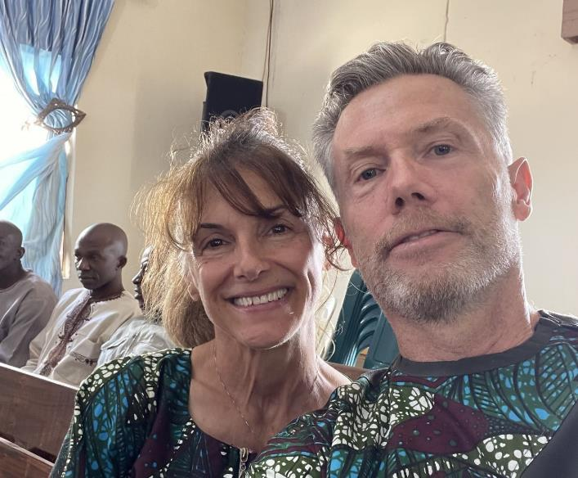
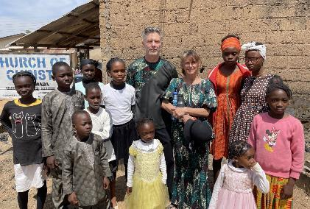
Wedding at Bauchi Ring Rd.
Tudan Wada
Notes:
Joseph Azembah, the Dean of Studies at SBS Jos is the preacher and an elder at Tudan Wada

Slide 6
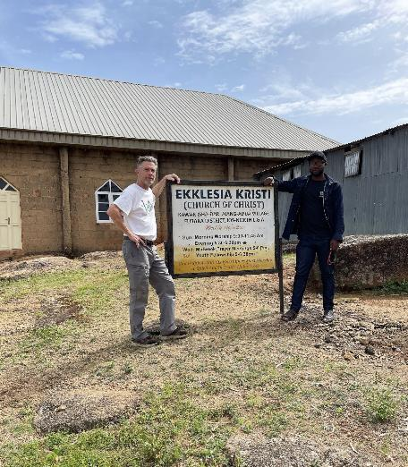
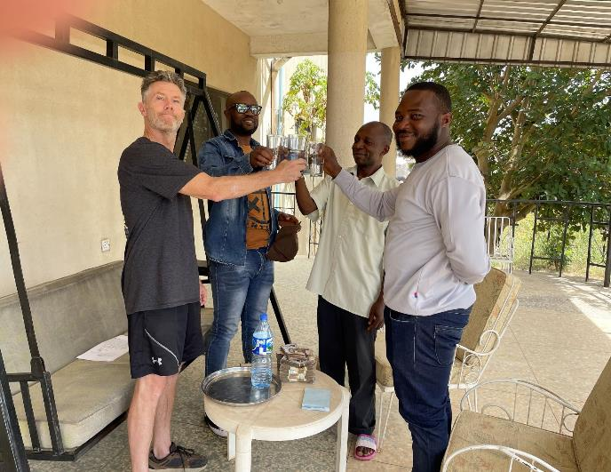
Jos Nigeria Water Projects
Link to Water Borehole Videos and Photos
Survey
Link to Water Borehole Document
Contracting
Notes:
We now move in to a canvas of the water borehole work we took on this time around. It proved to be an encompassing and rewarding project. We continue to regularly receive letters of gratitude and impact statements to the communities involved.
ALL IN ALL: 4 Boreholes at an average cost of $3500, Total project cost: $14,000.
This link provides further discussion on the water borehole project: Water Borehole Project Document
https://1drv.ms/b/s!AnLLCb3KRCI_gc9TCLNac5-rBhQnIw?e=x8mDwE
Link to Videos and Photos of Water Borehole Project: Link to Videos and Photos of Water borehole project
https://1drv.ms/u/s!AnLLCb3KRCI_gc9twcbxioOsR2nVhQ?e=6Rle47
Not our idea!! This was a “mission and outreach growth” prompted by a couple who will forever remain dear to us.
Started with a $10,000 budget…see what you can do. (we didn’t have the slightest idea!)….TEAMWORK :)
Upon arrival in Jos, solicited proposals, principally amongst the brethren (there are quite a few congregations)
Not necessarily a “church project”
General parameters: improve the quality of life by providing clean & sanitary water essential to:
Farming/food production
Health and sanitation
Homes and schools
Accessible to all (not church only), but to community at large
In good will and Christian charity, promote the sharing of the Gospel and evangelistic outreach
Develop Project Team…Can’t/don’t do this alone.
Team composed of key church leadership from around Jos, school representatives, trusted and affiliated contractors
Canvas proposals to frame scope of work….call for project bids/estimates
Align bids to budget, select and “award” bids [REALTIY CHECK]
Decided on three primary projects with a fourth project TBD
Furaka church of Christ & community
Kyan Rikkos community
Tudan Wada church of Christ & community
TBD: Alheri church of Christ & community (FEB 2023)

Slide 7
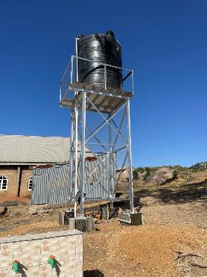
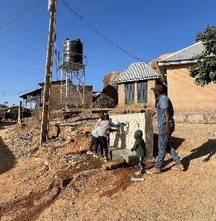
Prayer always!
Notes:
Not all boreholes produce.
Geologic surveys, determine likelihood and expected depth to water
We were blessed in all three of our projects with water obtained very close to expected depth
The cost of the metal for the stands was a big expense.
We purchased the material ourselves and used “trusted agents” for specific contractor specialties (electrical, plumbing, fabrication)
Tons of pictures, if you would like more information please let us know!
It is difficult in a few photos to convey the impact of these boreholes on the lives of the people. We can't but help take for granted the access and availability (at our immediate disposal) we enjoy of basic services ... but it is a far far different matter in underdeveloped areas of the world.

Slide 8
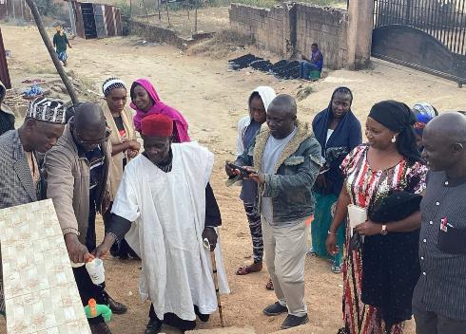
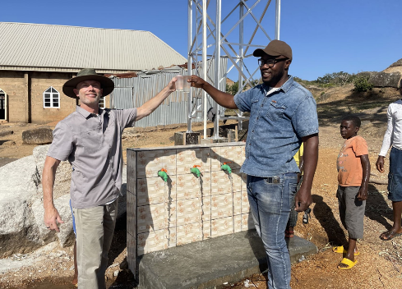
Notes:
Each borehole took about a week from drilling to being “online”
The Alheri project is 100% funded and scheduled for February 2023.
The picture upper right is a dedication at the Tudan Wada borehole site, with a local official giving thanks.
There was much rejoicing in being a recipient of one of these projects.
And God is able to make all grace abound toward you; that ye, always having all sufficiency in all things, may abound to every good work (2 Cor. 9:8)

Slide 9
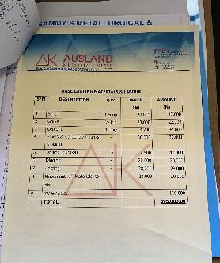
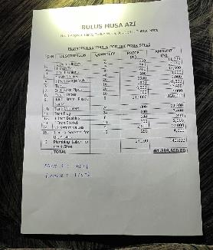
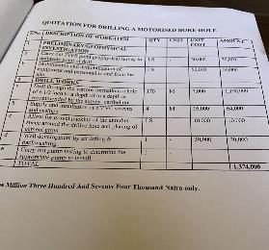
Financials
Notes:
Average total cost per borehole: $3500
Drill borehole: $1900
Pump, stand, tank, plumbing & electrical: $1200
Water tap stations: $400
Each project had separate contract. All documentation, invoices & receipts available as desired
Total project cost: $14,000.
$10,000 provided upfront by sponsors
$2000 provided by request to individual sponsors
$2000 provided by personal funds (non work fund)
Thank you to all who responded. All financial details are available for review as desired.
If congregation/individuals are interested in sponsoring (part or in full) a borehole... we have many more requests and we would be happy to work with you to make this happen!

Slide 10
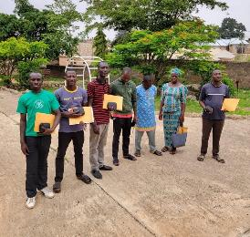
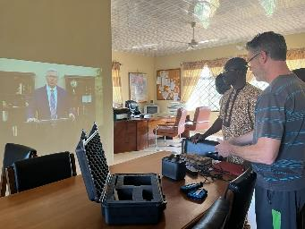
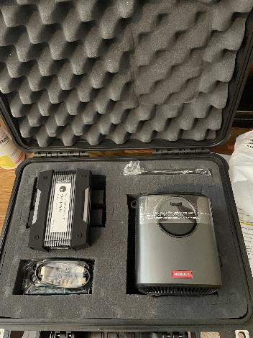
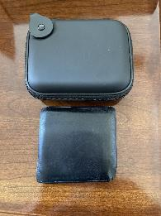
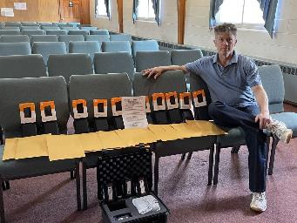
Kit to SBS President: Tom Ekpot Udoh
WVBS KIT
Graduating international students receiving hard drives
4 TB hard drives with WVBS material
Link to WVBS Evangelism Kits
Notes:
In August of 2021 I contacted WVBS and inquired about their evangelism kits and with the potential to bring a “couple” to Nigeria. We were initially given one kit.
Link to pictures featuring the WVBS Evangelism Kits https://1drv.ms/u/s!AnLLCb3KRCI_gdBhd8wQj_iVUfjgPw?e=sTtbyR
The kits must be hand carried, they consist of the entire library of WVBS (all their online bible school videos, and all of their topical studies).
Over 4 TB of biblical teaching material
the kits include 3 hard drives and a battery-operated projector that has a power capacity of 3.5 hrs.
In November 2021, I received 4 more kits (5 total) which included the course notes from all the bible school videos
WVBS encourages maximum distribution and has no restrictions on copying and sharing
Unable to go in May 2022 to the graduation commencement exercise, I copied all the material from the 3 drives onto a single 4 TB HD and sent 10 of these to select students. (mainly the international students)
The idea was to get the drives into as many countries as possible.
The 10 drives went to graduates returning to Uganda, Zimbabwe, Niger, Sierra Leone, Cameroon, Guiana, and Chad.
A drive was given to the school library, and several churches in Nigeria, also another Bible School (Darrell Memorial)
The Lord was with us and got us through customs!! We took all 5 kits with us when we left in August 2022. We were heavily screened and scrutinized, but when the agents were convinced, we were missionaries, and the identical kits were exactly as they looked (portable evangelism kits)…they let us through without difficulty. As long as the kits were not selling them there was no custom or import fees.
These kits were donated (sponsored) by congregations or individuals via the Church of Christ Donation Fund at WVBS.
In the upper right corner, the 1st of 5 kits is given to the President of SBS Jos, Dr. Tom Ekpot Udoh

Slide 11
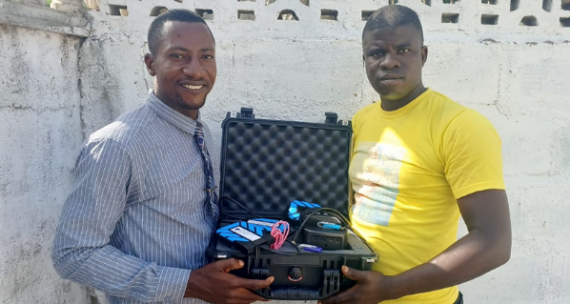
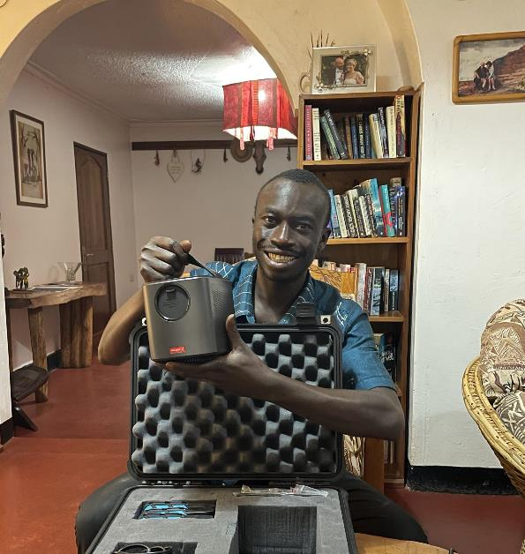
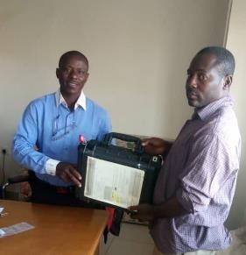
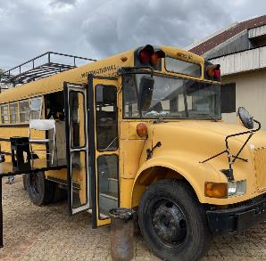
Sierra Leone: Peter and Michael
Eastern Uganda:
Wabomba George
Cameroon
Salvation Station
Notes:
One kit was given to the SBS school staff to use in their Extension Training Programs (Satellite Training including 2/3-week visits outside of normal school terms) and with the churches they serve.
Link to pictures featuring the WVBS Evangelism Kits: https://1drv.ms/u/s!AnLLCb3KRCI_gdBhd8wQj_iVUfjgPw?e=sTtbyR
One kit was given to the mobile Salvation Station which is a mobile Gospel Meeting and Evangelism Platform
One kit was given to graduating students who are active evangelists in Sierra Leone (Peter and Michael)
One kit was given to Wabomba George of Uganda who is doing tremendous work in his home region of Eastern Uganda.
Wabomba has baptized dozens of people in his first 5 months of ministry and has started a weekly radio broadcast.
One kit was given to a Bible school in Cameroon.
“For a day in thy courts is better than a thousand. I had rather be a doorkeeper in the house of my God, than to dwell in the tents of wickedness.” (Psa. 84:10)
We felt it a great privilege to be able to bring these great resources over to yokefellows in the Lord to enable them in the work.

Slide 12
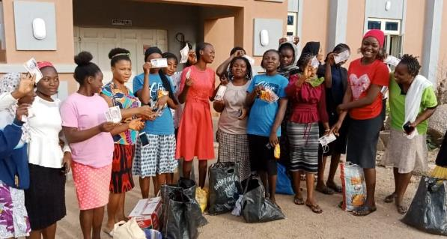
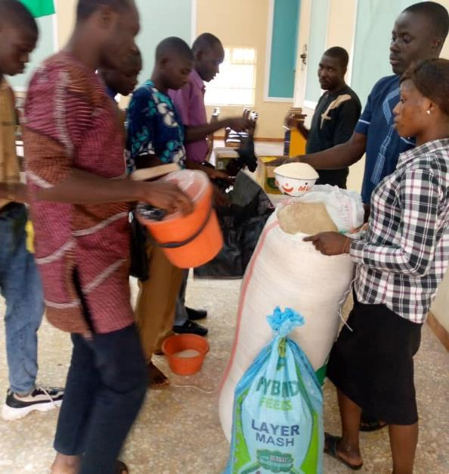
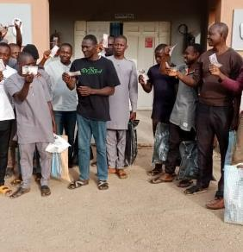
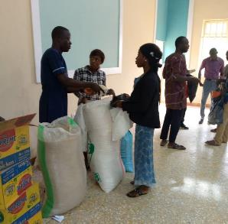
Food Relief and Support for SBS Students
Notes:
The combination of inflation and worldwide food shortages has made a difficult situation even worse.
The students run out of money and support toward the end of the semester, but this time food scarcity was prevalent throughout.
$1500 was raised for food support. These funds are being distributed in allotments. So far, $900 has been distributed…in just the first semester…more funds will be needed!!.
And God is able to make all grace abound toward you; that ye, always having all sufficiency in all things, may abound to every good work (2 Cor. 9:8)

Slide 13
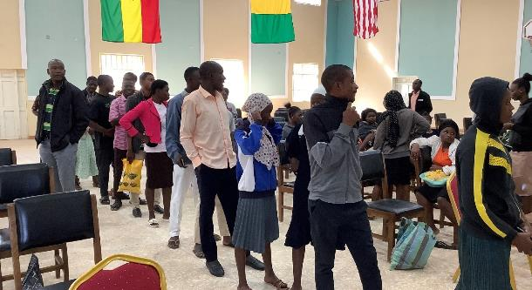
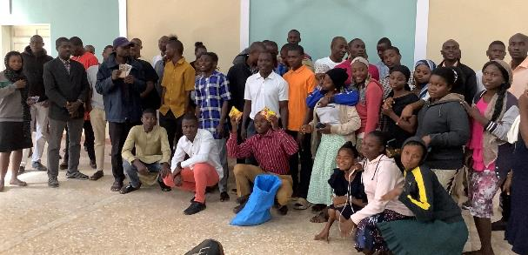
And God is able to make all grace abound toward you; that you, always having all sufficiency in all things, may abound to every good work (2 Cor. 9:8)
Food Relief and Support for SBS Students
Notes:
The combination of inflation and worldwide food shortages has made a difficult situation even worse.
The students run out of money and support toward the end of the semester, but this time food scarcity was prevalent throughout.
$1500 was raised for food support. These funds are being distributed in allotments. So far, $900 has been distributed…in just the first semester…more funds will be needed!!

Slide 14
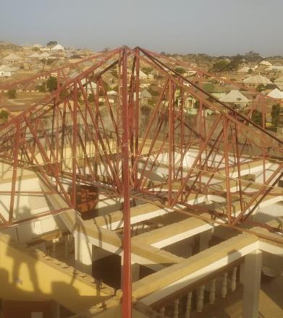
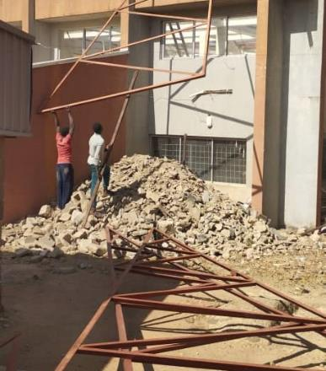
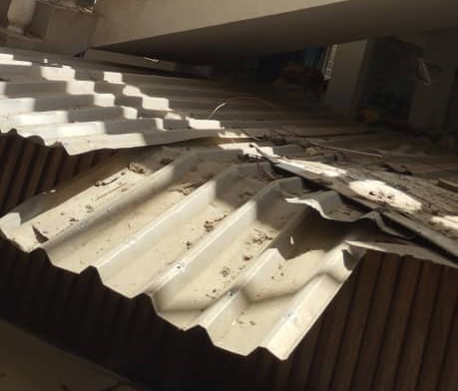
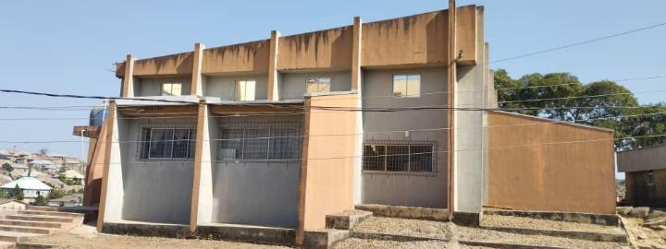
Library Roof Replacement
Link to Library Roof Repairs
DEC 2022
Notes:
The roof of the library was in dire need of replacement. It was the original roof.
The fund drive could not keep up with the rising price of the materials so early in the year the decision was made to purchase the materials and then replace the roof during the dry season. Roof replacement will complete in December 2022. The roof cost was ~ $15,000.
Link to Library Roof Repairs: https://1drv.ms/u/s!AnLLCb3KRCI_gc924FZsQSn57OTgEA?e=LF1bbZ
The brethren at the Antioch Church of Christ, Halls, TN provided critical funding toward the replacement of the roof! :)

Slide 15
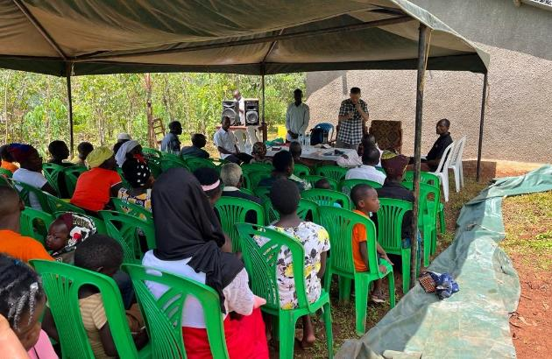
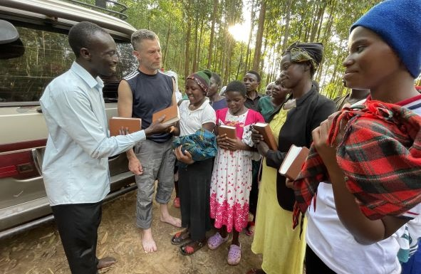
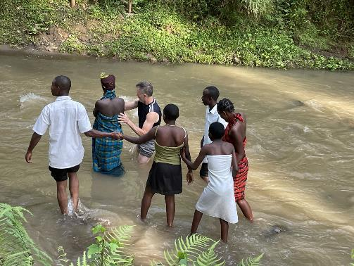
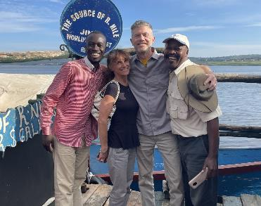
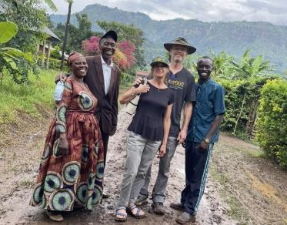
On to Uganda!
Bible gifts
As many as the Lord shall call
Door knocking or mud slinging!
Notes:
On to Uganda: All work and no play makes Chuck and Marci very dull servants!
Our host was brother Wabomba George, a graduate of SBS Jos (2022).
He invited us (pleaded with us) to come to Eastern Uganda because he was disturbed that the church was not growing. He had already established a radio ministry and was doing house to house evangelism. In the 5 months since he has graduated, he has baptized dozens of people.
We landed in southern Uganda at Entebbe Airport just outside of the capital city of Kampala. The situation was a bit tense because of the Ebola Virus outbreak which had been constrained to Western Uganda but there had been an isolated case in Kampala. We took necessary precaution (as advised by State Dept). Since our work was in Eastern Uganda, almost on the Kenya border, and there were no reported cases there, we decided it was reasonable enough to go. Once there, we found that inside Uganda, there was very little restriction or concerns in regions that had not had confirmed cases.
A bit of recreational tourism and site seeing on the way out. We stopped at the mouth of the Nile river which flows northward from Lake Victoria on a 4258 mile trek to the Mediterranean Sea at the Egyptian Delta of Cairo and Alexandria.
Once we arrived in Eastern Uganda, a beautiful region on the slopes of Mt. Elgon, we started our evangelism work. We started with house-to-house evangelism and found people very willing and receptive to hear and discuss the word of God. Many contacts and bible studies were set up for follow up work by the local brethren we were working with.
The height of the campaign was a two-day evangelism campaign at a local church in Namisdwa. Wabomba had converted the preacher there from denominationalism. As a result, they desired a church wide meeting. 6 people obeyed the Gospel call and it is expected that more will follow. Wabomba continues to work with them. At the end of the meeting the men presented us with a letter pleading with us to come back next and bring more people with us.

Slide 16
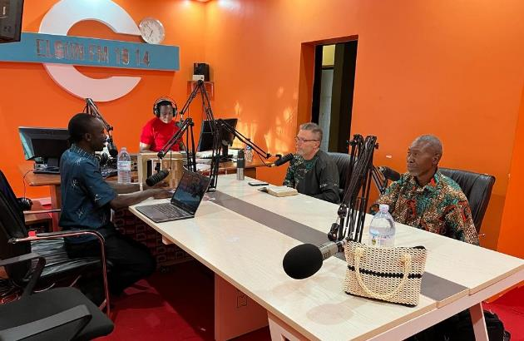
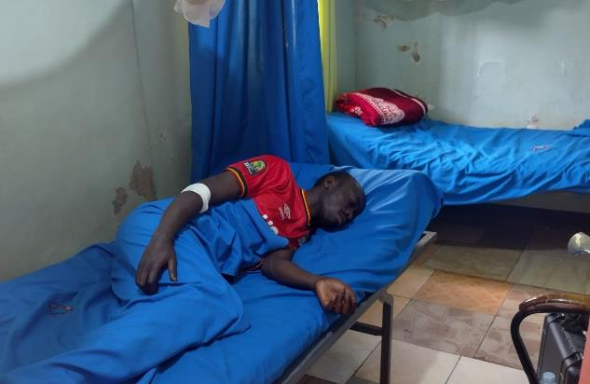
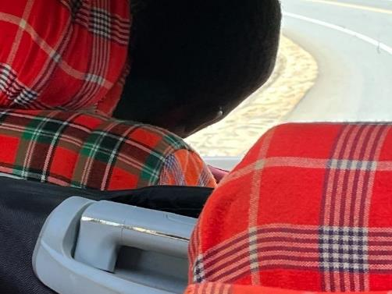
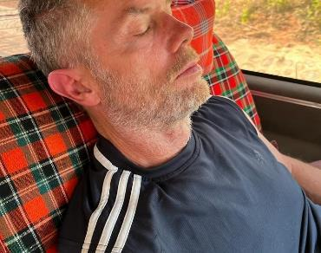
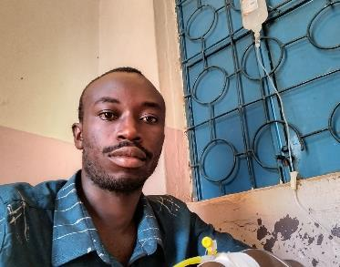
Evangelism Radio
Poor George…malaria again
Can’t a guy get a nap around here?
Notes:
On Sunday, before worship services, we were up early to do the weekly radio broadcast.
Wabomba has received great response and inquiry to his broadcasts.
A little down time when we could grab it on the long rides between points.
Malaria is a recurring infection and most people in Africa have it. It can be very disabling with fatigue, sickness, soreness, and fever. I guess we wore George down because he became ill at the end of our campaign.
It didn’t keep him from doing his radio broadcast though, He discharged himself from the hospital temporarily and went to do his broadcast (IV and all!!).
You can’t keep a good man down!! Though on his return to Eastern Uganda he had another recurrence as he hadn’t allowed himself to recover and went into the hospital ward again.

Slide 17
Murchison National Wildlife Park
Notes:
Uganda is called the “Pearl of Africa” and this park certainly justifies that claim.
We went on a dawn safari ride it was spectacular.
Lions, Elephants, Giraffes, Water Buffalo, Hippos, Crocodiles, all kind of game.

Slide 18
The last leg of a 30 hr trip home…
Notes:
The morning of December 1 we flew from Entebbe to Brussels at midnight. We connected to Newark. We had to change our flight to Boston because the CDC only allowed entry into the US from Uganda at 5 specific airports due to the Ebola outbreak.
From Newark…(no Ebola!!) we flew to Boston. At Boston we had quite a jolt as it was very windy and cold and we didn’t even have coats.
At Boston we caught the shuttle to Concord, a 2 hr bus ride. By the time we got to Concord that night (+ 8 hrs time difference), it was freezing. Then the wait for a taxi that could lug all our stuff back to the parsonage at the Concord church of Christ.
We left with 5 full check in bags and two carry ons. We came back fairly empty, as planned. We had the 5 evangelism kits, books, bibles, bible study and evangelism material we dolled out as we went along. We would have had very little to bring back, but we had to bring some gear to Uganda from Nigeria that will have to go back to Nigeria next time around.

Slide 19
Link to an Introduction to Wabomba George
Link to Mt Elgon Youth Conference
Notes:
Link to an Introduction to Waboma George: Eastern Uganda https://1drv.ms/u/s!AnLLCb3KRCI_gdBhd8wQj_iVUfjgPw?e=sTtbyR
Link to Mount Elgon Youth Conference: file:///C:\Users\crcor\OneDrive\Documents\Email%20attachments\Mount%20Elgon%20Youth%20Conference.pdf
Wabomba George makes me want to be a better man and a better servant.
When I grow up, I want to be like him.
My take home project is to find this amazing young, but godly man the support he needs to continue his work.
I would like to find a congregation or individual that would consider a 5-yr support partnership with brother George.
He recently via the radio broadcast shared the Gospel with a small congregation (9 people) resulting in the whole congregation being converted.

Slide 20
Link to Photos work in Sierra Leone
Link to an Introduction to Peter and Michael
Notes:
Link to Introduction to Peter and Michael at Sierra Leone file:///C:\Users\crcor\OneDrive\Documents\Email%20attachments\Intoduction%20to%20Wabomba%20George_%20Eastern%20Uganda.pdf
Link to Sierra Leone Pictures: https://1drv.ms/u/s!AnLLCb3KRCI_gc93etIHUulRUn98RQ?e=hFpV1P
Former graduates Peter and Michael are natives of Sierra Leone. Upon graduation they to returned to their home village and immediately went to work in the Lord's vineyard. They are very active in holding youth seminars and ladies' conferences as well as lectureships for area preachers to share the material they have received.
Like brother George, in Uganda, I would like to find a congregation or individuals who would support them for a 5-yr partnership.

